Slide 1


Slide 2
Our Vision
AI for Better Lives
Our Purpose
A non-profit Organisation that Promotes Advancement and Responsible use of AI to Benefit Humanity
Our Values
We value Innovation, Inclusivity and Ethics

Slide 3
Our Background
Inspired by Government of Zimbabwe's National Development Strategy (NDS12) and Vison 2030
Inspired by SADC Vision 2050, African Union's Agenda 2063 and UN Sustainable Development Goals
Drawing inspiration from similar organizations
Recognizing the transformative potential of AI and other accelerating technologies
The need for a unified national and continental voice and collective action in AI

Slide 4
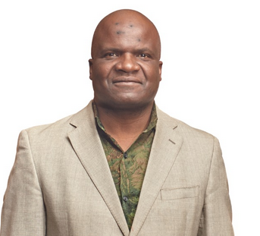

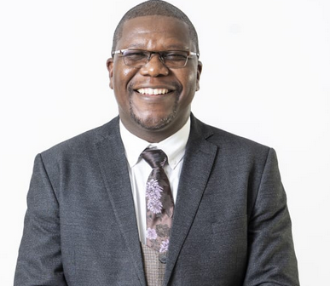
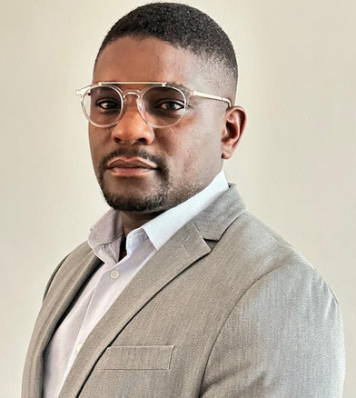
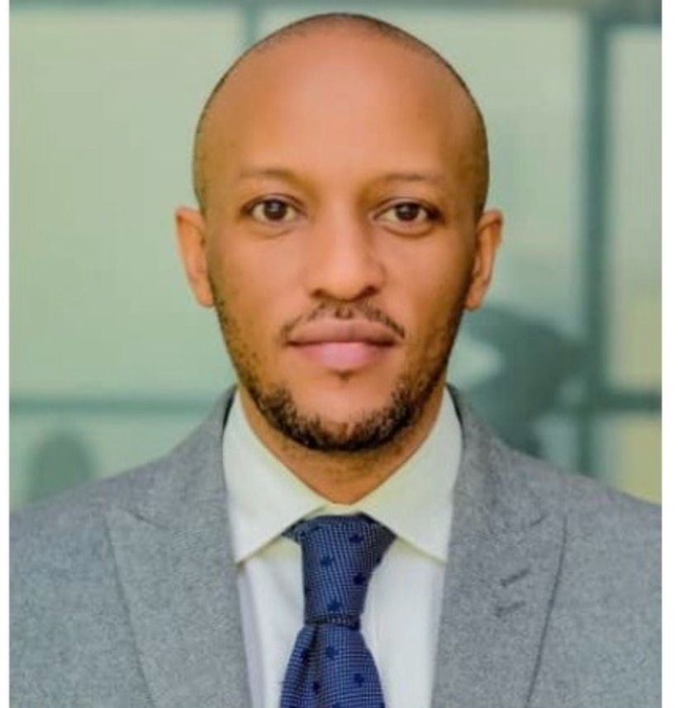
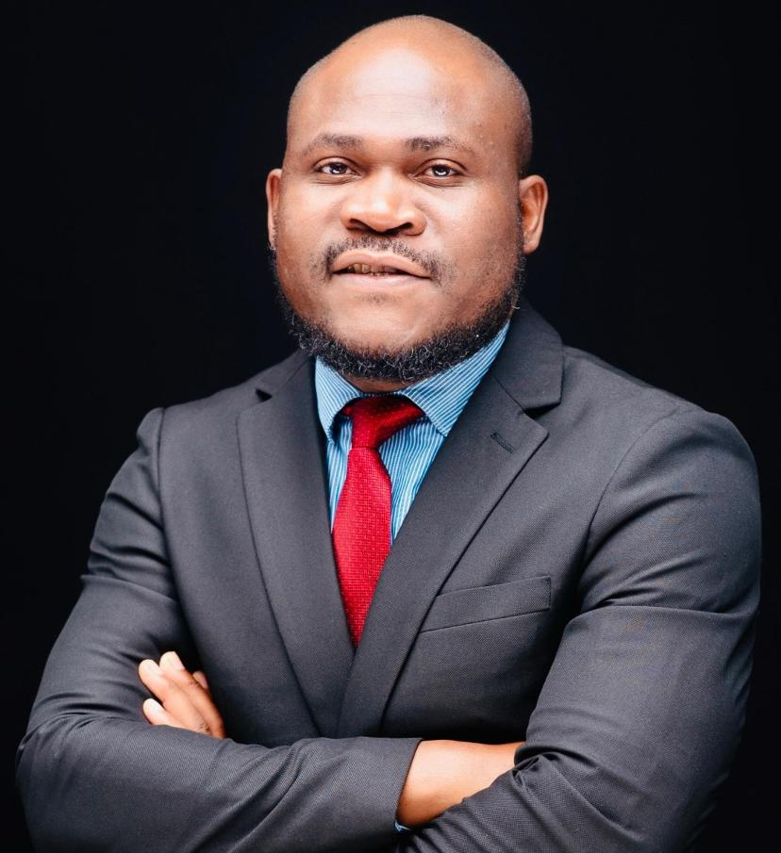
Our Governance – Aiia Board
Dr Dennis Magaya
Chairperson
Dr Licky Arastus
(Namibia)
Deputy Chairperson
Mr Cleopas Chiketa
(Zimbabwe)
Deputy Chairperson
Mr Robert Rusike
Treasurer
Mr Konde Bogingo
(Rwanda)
Mr Bram Fudzulani
(Malawi)

Slide 5
Our Goals
Establish an AI think Tank
Contribute to AI Policy , Ethics and regulatory frameworks
Develop HR Capacity, skills and literacy
Consultancy and advisory Services
Develop Data Sets and Algorithms for Africa
Foster Industry Collaboration, Networking and Knowledge Sharing in Africa
Promote responsible AI Innovation, research and development in the continent

Slide 6
Our Reach
Mozambique
Tanzania
Egypt
Malawi
South Africa
Zimbabwe
Namibia
South Africa
Ghana
Rwanda
Sierra Leone
Botswana
Kenya
Nigeria
eSwathini
Mozambique

Slide 7


Our Partners

Slide 8
Our Services
AI Policy , Strategy and Ethics Advisory
Training
Research
Consultancy
AI Solutions Innovation

Slide 9
Our Membership
Student Member
Member
Fellow
Intuitional

Slide 10
Our Membership Benefits
AI Training or Certification
Access to attachment
Mentorship
Networking
Discount on AI products and services
Provide Consultancy or Training Services
Participate in AI stakeholder Engagements or Collaborations
Speak at Conferences and Events
Branding , Marking and Sales

Slide 11
RIFTS-X - Records Intelligence & File Tracking System X
RIFTS-X transforms traditional record-keeping into a secure, intelligent, fully auditable ecosystem — managing both physical and digital files with zero-deniability accountability.
Core Capabilities
AI-Powered Smart Search & Discovery
Physical + Digital File Tracking
Immutable Audit Trail (Blockchain-Style Logs)
Secure Shareable File Access
Automated Borrowing & Custody Enforcement
Strategic Impact
⚡ 10x Faster Retrieval
🔐 Zero-Trust, Military-Grade Security
🧾 Zero Lost Files
🧠 AI-Driven Accountability
🌍 Secure Remote Collaboration

Slide 12
Cognify
AI-powered optimization and intelligence system designed to improve learning using multi-modal, multi-language, avatar-based, KTCE among other ways of learning
How Cognify Helps Organisations
Cognify’s optimisation power extends across organisational use cases:
Business & Enterprise
Efficient AI Integrations:
Improves internal AI workflows (e.g., automated reporting, knowledge summaries, customer support bots).
Cost-Smart AI Deployments:
Reduces cloud/compute bills by choosing optimized execution plans.
Higher Output Quality:
Better results from workflows that combine multiple AI steps (e.g., data retrieval → reasoning → answer generation).

Slide 13
AI TRAINING
Core Program Tracks
Foundational & Career Programs
3-Day Intensive Course – Quick introduction to AI fundamentals.
6-Month Professional Course – Comprehensive training for practical AI skills.
12-Month Advanced Diploma – Deep professional certification.
Leadership & Role-Based Courses
Master AI for Directors – Short course for board members and C-suite.
Master AI for Executives – Targeted at senior leaders.
Master AI for Professionals – Professional development.
Applied AI for Business Professionals – Practical AI use for roles like banking and finance.

Slide 14
AI Institute Africa – 2026 National & Sector Summits
AI Tech Forum Zimbabwe 2026
Theme: Mastering AI Systems: Building Zimbabwe’s Intelligence Edge
📍 May 2026 | Nyanga
Focus Areas:
AI Applications, Models & Frameworks
Machine Learning & Deep Learning
AI Infrastructure (Compute, Storage, Cloud)
Performance, Optimisation & Scalability
Research Collaboration & Data Readiness
Audience:
Researchers, engineers, AI specialists, government tech leaders, startups, innovators.

Slide 15
CONT.
Zimbabwe 2.0 – AI for National Transformation 2026
Theme: Intelligence as National Infrastructure
📍 May 2026 | Nyanga
Focus Areas:
AI for Government & Judiciary
AI for Socio-Economic Development (Vision 2030 / NDS2)
AI Infrastructure & Regional Integration
Investment, Innovation & Financing
Ethics, Governance, Privacy & Cybersecurity
Audience:
Government leaders, regulators, business executives, academia, startups, development partners.

Slide 16
CONT.
AI Africa Summit 2026
Theme: Africa 2.0: Ubuntu Algorithms for AI-Augmented Transformation
📍 August 2026 | Victoria Falls
Focus Areas:
National AI Policy
AI in Mining, Energy, Agriculture & Healthcare
AI-Driven Economy & Funding
Digital Infrastructure & Cybersecurity
Data Ethics & Policy Harmonisation
Audience:
Governments, investors, AI engineers, industry leaders, academia, regional & international institutions.

Slide 17
CONT.
AI Education Africa 2026
Theme: Transforming Education Through AI
📍 October 2026 | Harare
Focus Areas:
AI in Primary, Secondary & Tertiary Education
AI for Teachers & Learners
Future Skills & Jobs
Data Governance & Ethics in Education
EdTech Innovation & Regional Collaboration
Audience:
Schools, universities, regulators, researchers, students, EdTech startups, investors, development agencies.

Slide 18



Admin@aiinstituteafrica.com
www.aiinstituteafrica.com
@aiinstituteafri
LinkedIn
Facebook
275 Hebert Chitepo Ave
Harare , Zimbabwe

